Slide 1
Webmonk (day - 1)
Topics covered:
* Dev Environment Setup * HTML (Basics, Document Structure, Anatomy of tags, Mostly used tags, Special Characters)
* Semantic HTML (HTML 5 Guidelines, new additions, small HTML Blog project)

Slide 2
Dev Environment Setup

Slide 3
Signup for GitHub account.
Any updated browser.
VS Code setup & extensions (Emmet, Live Server & HTML CSS Support)

Slide 4
HTML

Slide 5
Basics of HTML
HTML – Hyper Text Markup Language
Created in 1991 by Tim Berners-Lee, known as founding father of modern Internet.
Initial version released in 1993.
Managed by W3C.
Latest version: HTML5

Slide 6
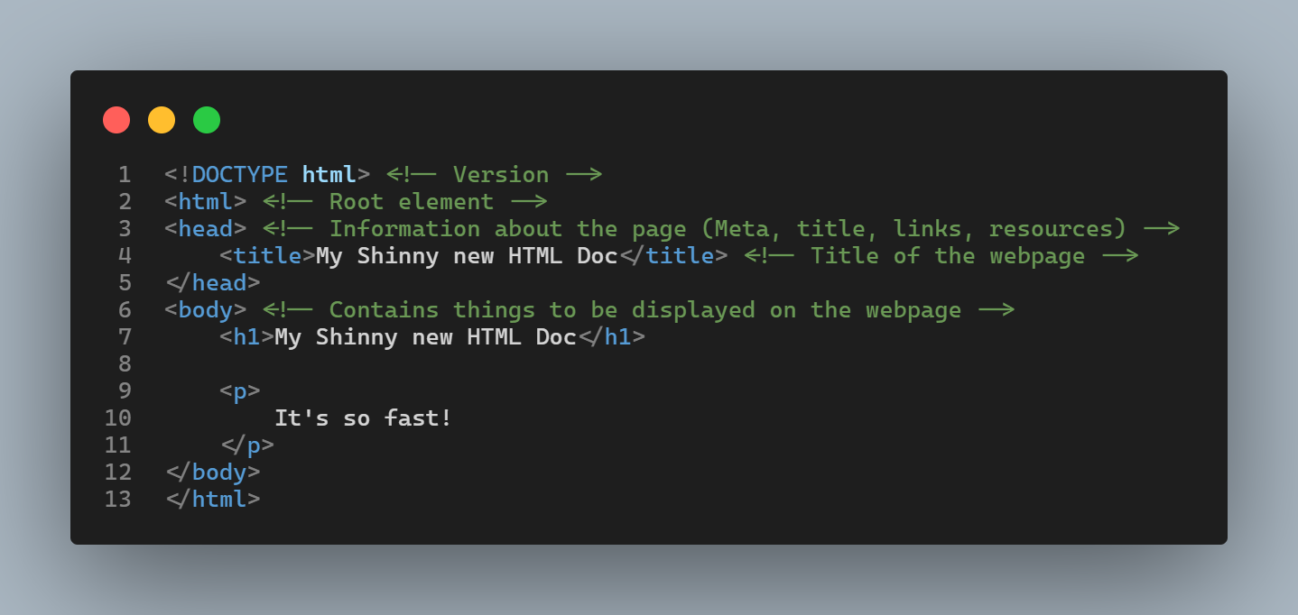
Basic Document Structure
* This is basic HTML required to view in browser.
* HTML is rendered sequentially from top to bottom.
* Let’s learn a little about this syntax

Slide 7
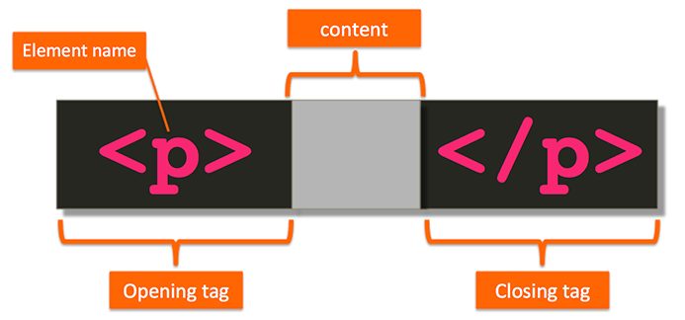
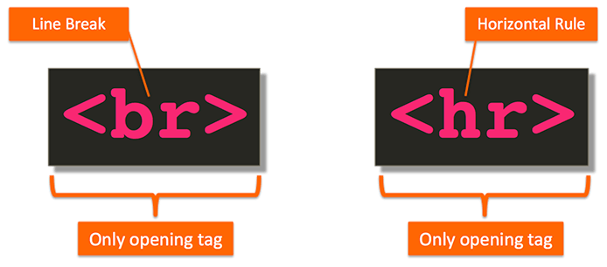
Anatomy of HTML tag
* HTML markup consists of tags that describe the content and tell the browser how to structure & display it.
* A pair of HTML tags and their enclosed content are collectively called an element.

Slide 8
Different types of elements
Block level Element
Inline Elements
Render to begin on a new line (by default)
May contain inline or other block-level elements
For ex: <div>, <p>, <h1>-<h6>, <ul>, <ol>, <li>
Render on the same line (by default)
May only contain other inline elements
For ex: <a>, <b>, <strong>, <img>, <span>

Slide 9
Mostly used tags
<h1>, <h2>..,<h6> tag - HTML headings
<p> tag – Paragraph
<img> tag – Image on page
<!-- --> tag – For comments in code
<br> tag – Line Break
<a> tag – Links in HTML document
<sup>, <sub> tag – Superscript & Subscript small text respectively.
<strong>, <em> tag – Text formatting (bold & italic respectively).
<ul>, <ol> tag – Unordered & ordered lists
<table> tag – Table in HTML document
<div> tag – Division tag used as a block in a document used mainly to layout sections in the design of the page.
<input> tag – To take different kinds of input from user.
<form> tag – Form for user input which wraps the input fields.
<style> tag - Wraps or includes CSS code.
<script> tag – Wraps or includes JS code.

Slide 10
Semantic HTML

Slide 11
WHAT semantic Elements means?
Introduced in HTML5.
These describes the meaning of element to both the browser and the developer.
These are block level element.
These helps in accessibility features.
For Ex: <article>, <aside>, <footer>, <header>, <main>, <nav>, <section>

Slide 12
Let’s Dive into some code, shall we?

